Slide 1

The React Way

Slide 2
Agenda
React Components
User Interface Decomposition
State and Props
Component Interaction
Class vs. Functional Components

Slide 3
React Components
The building blocks of a React application
Extends `React.Component`
Implements `render` function which returns the JSX element
Accepts Props
Immutable input data
Manages state
Data controlled by the component
React components should begin with a Capital letter

Slide 4
React.Component - Example
import React from 'react';
export default class Title extends React.Component {
render() {
return (
<h1>Welcome To React</h1>
)
}
}

Slide 5
React.Component - Example
import React from 'react';
import Title from './components/title';
export default class App extends React.Component {
render() {
return (
<div className="container">
<Title />
</div>
)
}
}

Slide 6
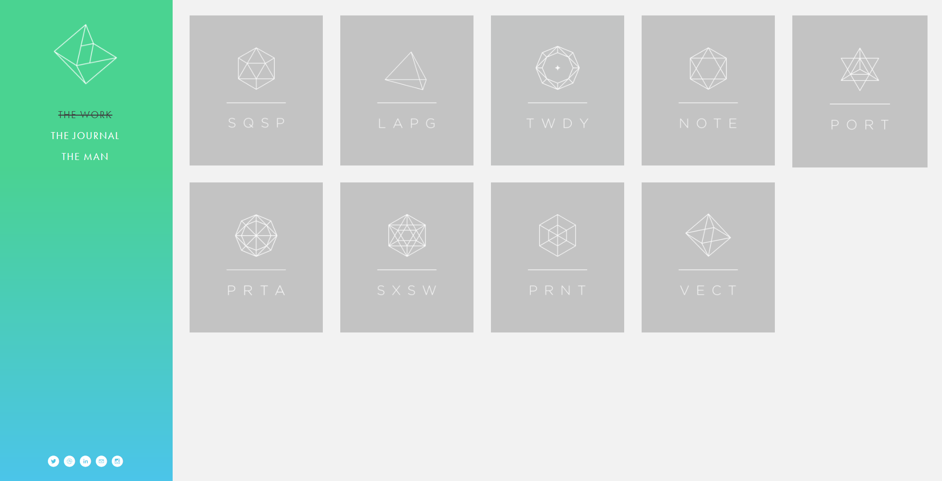
User Interface Decomposition

Slide 7
User Interface Decomposition
SideBar
MainContent

Slide 8
User Interface Decomposition
Logo
Menu
SideBar Component
SocialMenu

Slide 9
User Interface Decomposition
Portfolio Element
Portfolio Image
Portfolio Title

Slide 10
Component Structure
Components should be bite-sized
Focused responsibility (single responsibility pattern)
Reusable (if possible)

Slide 11
React Component - Props
Props are JS variables​
Input passed from a parent component
It’s part of the unidirectional data flow of React
Props are immutable
You pass props like regular HTML attributes <Greeter name=“john doe” />
Notes:
[GN] Semantic Changes

Slide 12
Passing Component Props
export default class Menu extends React.Component {
render() {
return (
<nav className="navbar navbar-default">
<div className="container-fluid">
<ul className="nav navbar-nav">
<MenuItem title="Portfolio" key="portfolio" />
<MenuItem title="About" key="about" />
<MenuItem title="Contact" key="contact" />
</ul>
</div>
<div className="navbar-form navbar-left">
<Search />
</div>
</nav>
)
}
}

Slide 13
Using Component Props
export default class MenuItem extends React.Component {
render() {
return (
<div className="col-md-3 portfolio-item">
<h5>{this.props.title}</h5>
<img src="{this.props.image" />
</div>
)
}
}

Slide 14
React Component State
Component's state is a simple JavaScript object
It includes data managed by the component
It is mutable
You set the initial state in the constructor without using setState
You change state by calling `this.setState`
Notes:
[GN] Semantic Changes

Slide 15
React Component State
export default class Menu extends React.Component {
constructor(props) {
super (props);
this.state = {
menuItems: [
{title: 'Portfolio', key: 'portfolio'},
{title: 'About', key: 'about'},
{title: 'Contact', key: 'contact'},
]
}
}
render() {
return (
<ul className="nav navbar-nav">
{
this.state.menuItem.map((item) => {
return <MenuItem title={item.title} key={item.key} />
})
}
</ul>
)
}
}

Slide 16
Component's setState
`setState` allows you to update component state (ctor excluded)
React merges the specified object into the current state (shallow)
Kicks off React's reconciliation process –
Causes component tree to re-render
Virtual DOM comparison
DOM changes
setState effects can be asynchronous (usually)
setState effects can be batched for better performance
Notes:
Async – as long as it happens in a controlled event managed by React, for example timers are not.

Slide 17
setState Asynchrony
If you need to reference state
Don't rely on 'this.state' when calculating next state
Can use a function instead to get the previous state and current props
Problematic
Recommended
this.setState(
(prevState, curProps) => (
{ counter: prevState.counter + 1, }
)
);
this.setState(
(prevState, curProps) => (
{ counter: prevState.counter + 1, }
)
);
this.setState(
{ counter: this.state.counter + 1, }
);
this.setState(
{ counter: this.state.counter + 1, }
);
Notes:
[GN] [Minor Design Changes]

Slide 18
setState(updater[, callback])
setState receives an optional callback parameter
Called after state change is applied and the component is re-rendered
A good place for executing state related side-effects
Not ones that affect render though
The callback is executed after re-rendering
Avoid multiple re-renders
In such cases, use setState with an updater function
Alternatively, can use 'componentDidUpdate'
Will be covered in a later module

Slide 19
React Events
React uses SyntheticEvent
A wrapper around the native event
Syntax is similar to vanilla JS (just with camelCase)
E.g. `onClick` instead of `onclick`
Event instances are pooled to improve performance
Can’t be accessed asynchronously (properties are nullified and changed)
Listeners can receive SyntheticEvent parameter
stopPropagation / preventDefault / etc.
Don’t forget to maintain the correct “this”
Notes:
Events only exist while they are used (they will then

Slide 20
React Events – Losing Context
An event listener may lose its execution context
"this" can no longer be the component instance
Several alternatives to work around this
Use arrow functions as it preserves the context (definition or JSX)
Bind the function to `this` in the constructor (this.func = this.func.bind())
Bind the function in JSX (<button onClick={this.func.bind()} />)
Notes:
Events only exist while they are used (they will then

Slide 21
React Events - Example
export default class Title extends React.Component {
handleClick(e) {
e.stopPropogation();
console.log('button was clicked’);
// do something
}
render() {
return(
<div>
<h1>Welcome To React</h1>
<button onClick={((e) => this.handleClick(e))}>
- We use an arrow function to preserve context
</button>
</div>
)
}
}
We use an arrow function
to preserve context

Slide 22
React Functional Components
React components can also be written as a function
Functional components are used when you don’t need state or lifecycle
Just render according to certain props
A functional component accepts props and returns a JSX element
Simpler to read and understand
export default function(props) {
return (
<div>This is a {props.type} component</div>
)
}
Notes:
[GN] removed last sentence (future performance improvement) and moved in the next slide (code demo)

Slide 23

Demo – building a simple Reddit

